Slide 1
Disjoint-set data structure
A disjoint-set data structure, or a union–find data structure or merge–find set:
a data structure that keeps track of a set of elements partitioned into a number of disjoint (non-overlapping) subsets.
It provides near-constant-time operations to add new sets, to merge existing sets, and to determine whether elements are in the same set.
In addition to many other uses, disjoint-sets play a key role in Kruskal's algorithm for finding the minimum spanning tree of a graph.
1

Slide 2
Operations
MakeSet
MakeSet operation makes a new set by creating a new element with a unique id, a rank of 0, and a parent pointer to itself. The parent pointer to itself indicates that the element is the representative member of its own set.
time complexity: O(1) .
function MakeSet(x)
if x is not already present:
add x to the disjoint-set tree
x.parent := x
x.rank := 0

Slide 3
Operations
Find
Find(x) follows the chain of parent pointers from x upwards through the tree until an element is reached whose parent is itself. This element is the root of the tree and is the representative member of the set to which x belongs, and may be x itself.
Path compression, is a way of flattening the structure of the tree whenever Find is used on it. Since each element visited on the way to a root is part of the same set, all of these visited elements can be reattached directly to the root.
function Find(x)
if x.parent != x
x.parent := Find(x.parent)
return x.parent

Slide 4
Operations
Union
Union(x,y) uses Find to determine the roots of the trees x and y belong to. If the roots are distinct, the trees are combined by attaching the root of one to the root of the other.
Union by rank always attaches the shorter tree to the root of the taller tree. Thus, the resulting tree is no taller than the originals unless they were of equal height, in which case the resulting tree is taller by one node.
To implement union by rank, each element is associated with a rank. Initially a set has one element and a rank of zero. If two sets are unioned and have the same rank, the resulting set's rank is one larger; otherwise, if two sets are unioned and have different ranks, the resulting set's rank is the larger of the two.
Ranks are used instead of height or depth because path compression will change the trees' heights over time.

Slide 5
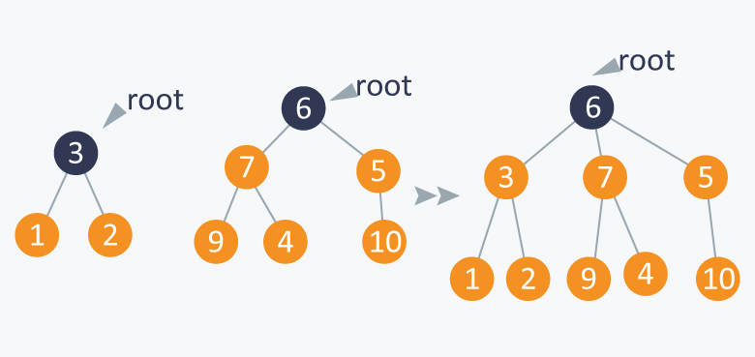
Union Operation

Slide 6
Operations
function Union(x, y)
xRoot := Find(x)
yRoot := Find(y)
// x and y are already in the same set
if xRoot == yRoot
return
// x and y are not in same set, so we merge them
if xRoot.rank < yRoot.rank
xRoot.parent := yRoot
else if xRoot.rank > yRoot.rank
yRoot.parent := xRoot
else
//Arbitrarily make one root the new parent
yRoot.parent := xRoot
xRoot.rank := xRoot.rank + 1

